Slide 1
Solving Op Amp Stability Issues Part 2
(For Voltage Feedback Op Amps)
Tim Green & Collin Wells
Precision Analog Linear Applications
<number>
Notes:
This presentation will focus on techniques to solve voltage feedback op amp stability problems. The content is intended to teach any range of professional, from technician to PHD, to become an op amp stability expert!
<number>

Slide 2
Stability Analysis - Method 2 (Aol and1/β Technique) (CF Compensation)
Notes:
There are two basic methods for analyzing op amp stability problems. The second method, Method 2, will use the Aol and 1/β Technique to analyze stability problems due to capacitive loading of an op amp input. The compensation used for this example will be CF Compensation.

Slide 3
Large Input Resistance & Input Capacitance
Do you want this hidden in
your product - in production?
<number>
Notes:
<number>
Large input resistances can combine with op amp input capacitance to create unanticipated and undesired instabilities as shown above in the transient response of the OPA140 in an inverting Gain = -1 configuration with RF=RI=180k ohms.

Slide 4
Aol and 1/β
<number>
Notes:
<number>
We can use our SPICE Loop Gain Test circuit above to plot Aol and 1/β for this Gain = -1 circuit. Note that the 1/β curve has a zero in it at 104kHz. At fcl, where Loop Gain (Aolβ) goes to zero, we see that the 1/β curve intersects the Aol at a rate-of-closure that is 40dB/decade which by our criteria implies an UNSTABLE circuit.

Slide 5
Op Amp Input Capacitance
<number>
Notes:
To properly analyze this circuit and thus properly compensate it for stability we first must analyze the OPA140 op amp input capacitance. The datasheet excerpt for the OPA140 is shown here with Input Impedance parameters for Differential and Common-Mode. The input capacitance model for the OPA140 is also shown. From the data sheet we can assign values for the capacitances shown, Ccm+, Ccm-, and Cdiff.

Slide 6
Equivalent Input Capacitance and β
<number>
Notes:
<number>
From our input capacitance model for the OPA140 and the circuit topology it is configured in we see there is a net input capacitance, Cin_eq which will affect our feedback factor, β, over frequency. Since the Cin_eq capacitor is buffered by RF, 180k ohm resistor, there are no loading effects on Aol with this circuit topology and so the Aol remains unchanged.

Slide 7
Equivalent Input Capacitance and 1/β
(Set to 1V)
β
<number>
Notes:
<number>
Our β network is shown above. β is easy to compute if one sets VOUT = 1. β=(input impedance)/(feedback impedance + input impedance). Recall that 1/β is just the reciprocal of β. From our derived and simplified equations above we see a zero, fz1, in the 1/β plot due to RF, RI and Cin_eq. Note that although our closed loop gain is -1 our 1/β is at 6dB or x2. Remember our earlier discussion of noise gain and to view the op amp, from a loop gain view, to always be running in a noise gain equivalent to putting a noise source on the +input of the op amp and running in the non-inverting gain based on feedback and input impedances from output to –input.

Slide 8
CF Compensation Design Steps
Determine fz1 in 1/β due to Cin_eq
Measure in SPICE
OR
B) Compute by Datasheet C_{DIFF}and C_{CM} and Circuit RF and RI
Plot 1/β with fz1 on original Aol
3) Add Desired fp1 on 1/β for CF Compensation
Keep fp1 < 10*fz1
Keep fp1 < 1/10 * fcl
4) Compute value for CF based on plotted fp1
5) SPICE simulation with CF for Loop Gain (Aolβ) Magnitude and Phase
Adjust CF Compensation if greater Loop Gain (Aolβ) phase margin desired
7) Check closed loop AC response for VOUT/VIN
Look for peaking which indicates marginal stability
Check if closed AC response is acceptable for end application
8) Check Transient response for VOUT/VIN
A) Overshoot and ringing in the time domain indicates marginal stability
<number>
Notes:
<number>
The CF Compensation design steps are outlined here. Rules-of-thumb are presented to yield best stability on first pass analysis.

Slide 9
1),2),3) Plot Aol, 1/β, Add fp1 in 1/β for Stability
For fp1:
fp1 < 10 * fz1
fp1 < 1/10 * fcl
<number>
Notes:
<number>
Using our Loop Gain Test circuit in SPICE we can plot the Aol and 1/β for the uncompensated circuit as shown above. For best stability results on first pass we use the recommended rules-of-thumb shown and draw in what we want the final 1/β curve to look like. Based on this graphical approach we see we need a pole, fp1, added into the 1/β curve to allow the compensated 1/β to intersect the Aol at a rate-of-closure which is 20db/decade and thus stable by our criteria.
From above we have completed Steps 1, 2, and 3 for the CF Compensation Design:
Determine fz1 in 1/β due to Cin_eq
Measure in SPICE
Compute by Datasheet C_{DIFF} and C_{CM} and Circuit RF and RI
Plot 1/β with fz1 on original Aol
3) Add Desired fp1 on 1/β for CF Compensation
Keep fp1 < 10*fz1
Keep fp1 < 1/10 * fcl

Slide 10
4) Compute value of CF
<number>
Notes:
<number>
Our β network is shown above. β is easy to compute if one sets VOUT = 1. β=(input impedance)/(feedback impedance + input impedance). Recall that 1/β is just the reciprocal of β. From our derived and simplified equations above we see a zero, fz1, in the 1/β plot due to RF, RI, Cin_eq, and CF. Note that although our closed loop gain is -1 our 1/β is at 6dB or x2. Remember our earlier discussion of noise gain and to view the op amp, from a loop gain view, to always be running in a noise gain equivalent to putting a noise source on the +input of the op amp and running in the non-inverting gain based on feedback and input impedances from output to –input. Note that with the addition of CF Compensation the 1/β zero, fz1, is moved to a lower frequency since CF is in parallel with Cin_eq to determine the location of fz1. However, to choose the CF Compensation pole, fp1, it is only dependent upon Rf and CF.
From above we have completed Step 4 for the CF Compensation Design:
4) Compute value for CF based on plotted fp1

Slide 11
5), 6) Loop Gain Check
Phase Margin at fcl = 68 degrees
<number>
Notes:
<number>
Design Step 5 for CF Compensation is to check the final CF value chosen by a loop gain plot on the complete op amp circuit. We see from above that at fcl, where Loop Gain (Aolβ) goes to zero, the phase margin is 68 degrees. Step 6 is to adjust CF for more phase margin if we are not satisfied with our first analysis and re-run the loop gain and phase plot to check the final design. Here we are happy with 68 degrees of Loop Gain (Aolβ) phase margin.
From above we have completed Steps 5 & 6 for the CF Compensation Design:
SPICE simulation with CF for Loop Gain (Aolβ) Magnitude and Phase
Adjust CF Compensation if greater Loop Gain (Aolβ) phase margin desired

Slide 12
7) VOUT/VIN AC Response
<number>
Notes:
<number>
Design Step 7 for CF Compensation is to check the closed loop AC response over frequency. From above, see the closed loop AC response for both the output of the op amp, VOUT. If this closed loop bandwidth is not acceptable for the final application we will need to consider other capacitive stability techniques (see Appendix) or a different op amp or different feedback and input resistor values of lower values.
From above we have completed Step 7 for the CF Compensation Design:
Check closed loop AC response for VOUT/VIN
Look for peaking which indicates marginal stability
Check if closed AC response is acceptable for end application

Slide 13
8) Transient Analysis
<number>
Notes:
<number>
Design Step 8 for CF Compensation is to check the closed loop transient response. From above we see the closed loop Transient response for VOUT shows no signs of excessive overshoot or ringing before settling.
From above we have completed Step 7 for the CF Compensation Design:
Check Transient response for VOUT/VIN
A) Overshoot and ringing in the time domain indicates marginal stability

Slide 14
Stability Tricks and Rules-of-Thumb
Notes:
There are some handy stability tricks and rules-of-thumb that have been developed based on experience in stabilizing hundreds of op amp circuits. They are presented here to help you get op amp stability done quickly and right the first time.

Slide 15
Loop Gain Bandwidth Rule: 45 degrees for f < fcl
Aolβ (Loop Gain) Phase Plot
Loop Stability Criteria: < -180 degree phase shift at fcl
Design for: < -135 degree phase shift at all frequencies < fcl
Why?:
Because Aol is not always “Typical”
Power-up, Power-down, Power-transient → Undefined “Typical” Aol
Allows for phase shift due to real world Layout & Component Parasitics
Prevent excessive ringing due to phase margin dip near fcl
<number>
Notes:
<number>
The established loop stability criteria is less than a 180 degree phase shift at fcl, the frequency at which loop gain goes to zero. How close the phase shift is to a full 180 degrees phase shift at fcl is defined as phase margin. As detailed in this slide the recommended rule-of-thumb for real world circuits is to design for 135 degree phase buffer (45 degree away from 180 degrees phase shift) throughout the loop gain bandwidth (f < fcl). This allows for the real world cases of power-up, power-down and power-transient conditions where the op amp can have changes in its Aol curve which may result in transient oscillations. This is especially undesirable in power op amp circuits. This rule-of-thumb also allows for extra phase buffer in the loop gain bandwidth to account for additional real world phase shifts due to parasitic capacitances and PCB layout parasitics. Also, a phase buffer less than 45 degrees within the loop gain bandwidth can result in undesired peaking in the closed loop transfer function. The lower the phase buffer dip and the closer the dip is to fcl, the more pronounced the closed loop peaking will be.

Slide 16
Frequency Decade Rules for Loop Gain
For 45^{O} Phase Buffer away from 180^{O} Phase Shift
Loop Gain View: Poles: fp1, fp2, fz1; Zero: fp3
Rules of Thumb for Good Loop Stability:
Place fp3 within a decade of fz1
fp1 and fz1 = -135° phase shift at fz1
fp3 < decade will keep phase from dipping further
Place fp3 at least a decade below fcl
Allows Aol curve to shift to the left by one decade
<number>
Note locations of poles in zeroes in Aol and 1/β plots
Notes:
The “decade rules” for frequency in the Loop Gain plot are detailed in the slide above. These frequency decade rules will be used for 1/β plots and Aol plots as well as Aolβ, loop gain plots, which we can predict directly from the Aol and 1/β plots. For the circuit shown in this slide the Aol curve contains a second pole, fp2, around 100kHz due to the capacitive load, CL, and the op amp’s Ro. We will create a feedback network that will meet our Loop Gain Bandwidth rule of 45 degrees margin for f< fcl. We will analyze and synthesize the feedback network using the 1/β plot and Aol plot with the knowledge of what we are doing to the Loop Gain plot, Aolβ. fp1 gives us a first pole at 10Hz in the Loop Gain plot which implies a 45 degree phase shift at 10Hz with phase shifting to a 90 degrees by 100Hz. At 1kHz, fz1, a zero in the 1/β plot, we add a pole in the Loop Gain plot and another 45 degree phase shift at 1kHz. Our total phase shift now is -135 degrees at 1kHz. But if we continue on in frequency with just fz1 we will reach -180 phase shift at 10kHz!! So we add fp3, a pole in the 1/β plot, which is a zero in the Loop Gain plot at 10kHz. This keeps the phase shift at 1kHz to -135 degrees and flattens the phase plot to -135 degrees phase shift from 1kHz to 10kHz (remember poles and zeros have an effect a decade above and a decade below their actual frequency location). fp2 adds another pole in the Loop Gain plot at 100kHz since fp2 is from the Aol plot. Between 10kHz, where fp3 is, and 100kHz, where fp2 is, we expect no change in phase shift since fp3 is a Loop Gain plot zero and fp2 is a Loop Gain plot pole.
So if we keep poles and zeros spaced a decade away from each other they will keep the phase shift from dipping between them since each has an effect on one another a decade above and a decade below their location. The final key part of the Frequency Decade Rules for Loop Gain is to place fp3 no closer than a decade away from fcl. This allows for a decade shift in Aol towards the lower frequency range before we would be in a marginal stability condition. Typical Aol curves may shift as much as ½ decade in the real world.
The V_{OUT}/V_{IN} for this circuit is predicted to be flat until loop gain goes away at 100kHz, at which point it will then follow the Aol curve on down.

Slide 17
Frequency Decade Rules for Loop Gain Phase Plot Prediction
At fcl:
Phase Shift = 135^{O}
Phase Margin = 45^{O}
<number>
Note locations of poles in zeroes in Aol and 1/β plots
Notes:
<number>
This is the first order hand analysis prediction for the Loop Gain phase plot of the circuit described in the previous slide.

Slide 18
Op Amp Circuits & Second Order Systems
Most Op Amp Circuits are adequately analyzed, simulated, and real world tested using well-known second order system response behavior.
Most Op Amps are dominated by Two Poles:
Aol curve shows a low frequency pole, fp1
Aol curve also has a high frequency pole, fp2
Often fp2 is at fcl for unity gain
This yields 45 degrees phase margin at unity gain
<number>
Notes:
<number>
Most real world op amp circuits are dominated by a two pole, second order, system response. A typical op amp Aol has a low frequency pole in the 10Hz to 100Hz region and another high frequency pole at its unity gain crossover frequency, or soon after that in frequency. If pure resistive feedback is used we can see that the loop phase plot would demonstrate the effects of a two pole system. For more complicated op amp circuits the resultant loop gain and loop phase plots are usually dominated by a two pole response. Closed loop behavior of a second order system is well defined and offers us a powerful technique for a real world stability check.

Slide 19
Control Loop - Second Order System
<number>
Notes:
<number>
The traditional second order system control loop block diagram and characteristic equation are shown above. G(s) for us represents our closed loop, 2-pole dominant, op amp circuit. There are well established, documented, and derived behaviors for such a 2-pole dominant system that we can use to help us assess most op amp stability problems.

Slide 20
Indirect Phase Margin Measurements
Phase Margin can be measured indirectly on closed-loop circuits!
Time Domain → Percent Overshoot
AC Gain/Phase → AC Peaking
<number>
Notes:
Phase Margin can also be indirectly measured on closed-loop circuits in the time domain and in ac gain/phase measurements. In the time domain, we can observe phase margin based on the overshoot of an op amp’s output relative to a small-signal step input. In the frequency domain, we can observe phase margin based on the maximum AC peaking in the circuit’s transfer function compared to the DC gain.
<number>

Slide 21
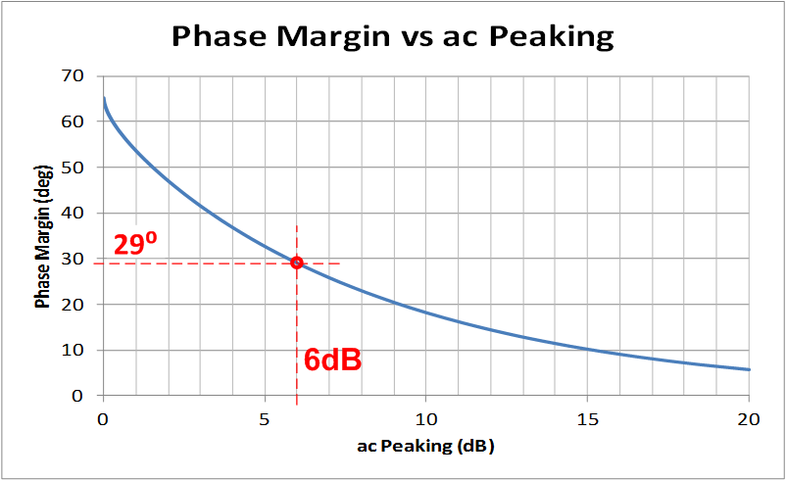

Closed Loop Peaking in AC Frequency Sweep vs Phase Margin
6dB
6dB AC peaking → 29° phase margin
<number>
Notes:
<number>
In AC Gain/Phase plots, the amount of ac peaking relative to the DC gain can be used to indirectly measure the phase margin of a circuit. In this example, the AC transfer function is peaking at 6dB, while the DC gain is 0dB. A total peaking of 6dB again results in 29 degrees of phase margin.

Slide 22
Transient Real World Stability Test
Test Tips:
Choose test frequency << fcl
“Small Signal” AC Output Square Wave (1kHz usually works well)
Adjust V_{IN} amplitude to yield output <50mVpp
Worst case is usually when V_{Offset} = 0 → Largest Op Amp R_{O} (I_{OUT} = 0)
Use V_{Offset} as desired to check all output operating points for stability
Set scope = AC Couple & expand vertical scope scale to look for amount of
overshoot, undershoot, ringing on V_{OUT} small signal square wave
Use X1 Scope Probe on V_{OUT} for best resolution
<number>
Notes:
<number>
This slide details the Transient Real World Stability Test. A small amplitude square wave is injected into the closed loop op amp circuit as the V_{IN} source. A frequency is chosen well within the loop gain bandwidth but also high enough to make triggering with an oscilloscope easy. 1kHz is a good test frequency for most applications. V_{IN} is adjusted such that V_{OUT} is 50mVpp or less. We are interested in the small signal AC behavior of the circuit to look for AC stability. To that end we do not want a large signal swing on the output which could also contain large signal limitations such as slew rate or output current limitations or output stage voltage saturation. V_{offset} provides a mechanism to move the output voltage up and down through its entire output voltage range to look for AC stability under all operating point conditions. For many circuits, especially those that drive capacitive loads, the worst case for stability is when the output is near zero (for a dual supply op amp application) and there is little or no DC load current since this results in the highest value of R_{O}, the op amp’s open loop small signal resistance. Record the amount of overshoot and ringing on the square wave output and compare it to the 2nd Order Transient Curves in the Slide 75 to derive the phase margin for stability.

Slide 23
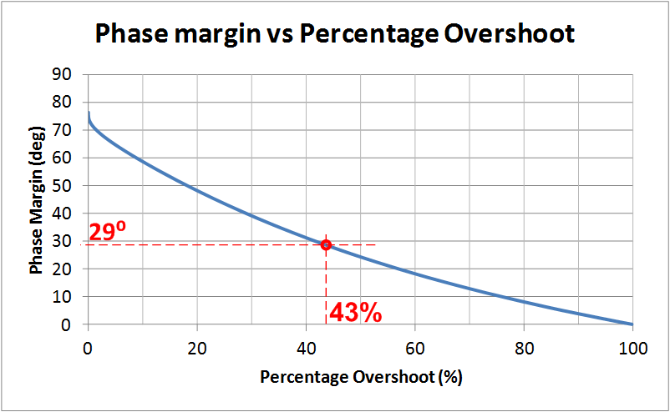

2nd Order Transient Curves
14.3mV
43% overshoot → 29° phase margin
<number>
Notes:
<number>
In the time domain the percent overshoot to a step input can be used to indirectly calculate the phase margin. In this example, a 10mV step was applied. The output overshoot reached 14.3mV, or 4.3mV above the intended output. This corresponds to a percent overshoot of 43%. Using the phase margin vs. percentage overshoot plot, we can see that 43% of overshoot results in only 29 degrees of phase margin.

Slide 24
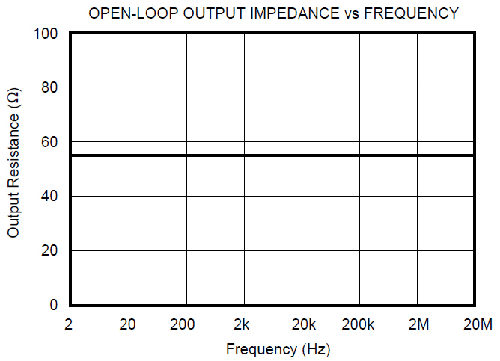
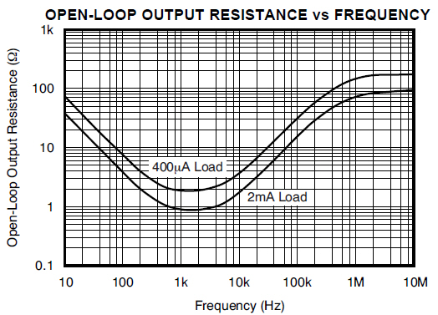
When R_{O} is really Z_{O}!!
OPA627 has R_{O}
OPA2376 has Z_{O}
Capacitive
Inductive
Resistive
OPA627
OPA2376
Resistive
Note: Some op amps have Z_{O} characteristics other than pure
resistance – consult data sheet / manufacturer / SPICE Model
<number>
Notes:
Not all op amps have open loop output impedance that is purely resistive. If it is not clear in the data sheet consult the manufacturer for the true unloaded Zo curve. Check the SPICE macromodel before relying on it for stability analysis in circuits where the correct Zo is critical for stability such as capacitive loading on the op amp output. See Appendix for a more detailed discussion of “Op Amp Output Impedance”.

Slide 25
Open Loop Output Impedance – SPICE Measurement
<number>
Notes:
For many op amp application circuits is will be necessary to know the op amp Open Loop Small Signal AC Output Impedance, Zo. Often this can be obtained from the op amp data sheet. Many op amp SPICE macromodels properly model Zo. If the data sheet contains a Zo curve we can easily check the macromodel for Zo accuracy. The test circuit here uses inductor, LT, in the feedback path to act as a short for the DC Operating Point analysis. The capacitor, CT, on the –input to ground is open for DC Analysis and will be a short for all frequencies of interest during the AC Analysis. Current Generator, IG1, is set to DC Current =0 and selected as AC Current of 1. During the AC Analysis IG1 injects current into the output, Vout, and the op amp is open loop. AC Analysis reports Vout in dB over frequency as a ratio of Vout/IG1 which is Zo, in dB. To convert Zo in dB to Zo in ohms simply change the y-axis scaling from dB-Linear to logarithmic.

Slide 26
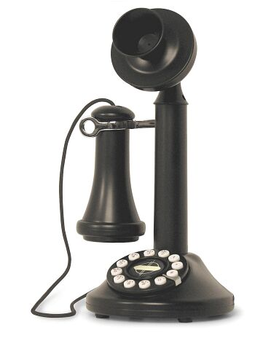
Summary for Stability
For Stability Loop Gain Analysis all we need is:
Aol – from op amp data sheet or macromodel
Zo – Op Amp open loop, small signal AC output impedance
from op amp data sheet or macromodel
3) 1/β – basic by application, modified for stability
4) Z_Load – given by application
Stability General Comments:
Stability by modifying 1/β will decrease closed loop bandwidth
Stability compensation can slow large signal response (charging of caps) – check it
Simulate AC Transfer function (Closed Loop AC Response) as final check
Simulate Small Signal Transient Response as final check
DC operation in the lab does not guarantee stability
Marginal stability can cause undesired overshoot and ringing
DC circuits can get real world transient inputs from supplies, inputs, or output
That ringing in your circuit is not your Grandmother’s dial telephone
<number>

Slide 27


Additional Design Resources:
http://www.ti.com/ww/en/analog/precision-designs/
TI Precision Designs
Three design levels from the desks of our analog experts.
TI Precision Designs
Hub blog
Get tips, tricks and techniques from TI precision analog experts
<number>

Slide 28

Technical Support: http://e2e.ti.com/
<number>

Slide 29
Acknowledgements
A special thanks to Jerald Graeme, whom we honorably dub
“The Godfather of 1/β” for his work at Burr-Brown Corporation, et ali, in research and writing about Op Amp Stability using 1/β.
Jerald Graeme Brief Biography:
From: http://electronicdesign.com/analog/jerald-graeme
When ICs and op amps were separate devices, Jerald Graeme was among the first to develop a combined IC op amp while at Burr-Brown, in a 1968 team effort with Motorola. He designed many more op amps and video amplifiers whose precision, high speed, or low drift amplification made them a very useful component in a variety of analog applications. Nine U.S. patents and numerous foreign counterparts resulted from these designs. The internationally acknowledged authority on electronic amplifiers wrote five very popular books about op amps, the latest being Photodiode Amplifiers: Op Amp Solutions and Optimizing Op Amp Performance. The latter, subtitled "A new approach for maximizing op amp behavior in circuit designs without extensive mathematical analysis," offers design equations and models that reflect real-world op amp behavior and makes analysis of difficult-looking configurations easy. Graeme's earlier books are: Op Amps: Design and Application, Designing with Operational Amplifiers, and Amplifier Applications of Op Amps. He expects signal processing with op amps to be the domain of digital devices, but they will still require an analog interface to integrate with real-world items like process control or avionics.
Jerald Graeme Books:
http://www.amazon.com/Jerald-G.-Graeme/e/B001HO9X60
<number>

Slide 30
Appendix
<number>

Slide 31
Appendix Index
Op Amp Output Impedance
Pole and Zero: Magnitude and Phase on Bode Plots
Dual Feedback Paths and 1/β
Non-Loop Stability Problems
Stability: Riso (Output Cload)
Stability: High Gain and CF (Output Cload)
Stability: CF Non-Inverting (Input Cload)
Stability: CF Inverting (Input Cload)
Stability: Noise Gain Inverting & Non-Inverting (Output Cload)
Stability: Noise Gain and CF (Output Cload)
Stability: Output Pin Compensation (Output Cload)
12) Stability: Riso w/Dual Feedback (Output Cload)
– Zo, 1/β, Aol Technique
13) Stability: Riso w/Dual Feedback (Output Cload)
–1/β, Loaded Aol Technique
14) Stability: Riso w/Dual Feedback plus RFx (Output Cload)
–1/β, Loaded Aol Technique
15) Stability: Discrete Difference Amplifier (Output Cload)
<number>

Slide 32
Appendix Index
<number>

Slide 33
1) Op Amp Output Impedance Open Loop (Z_{O}) & Closed Loop (Z_{OUT})

Slide 34
Op Amps and “Output Resistance”
Definition of Terms:
R_{O} = Op Amp Open Loop Output Resistance
R_{OUT} = Op Amp Closed Loop Output Resistance
R_{OUT} = R_{O} / (1+Aolβ)
<number>
From: Frederiksen, Thomas M. Intuitive Operational Amplifiers.
McGraw-Hill Book Company. New York. Revised Edition. 1988.
Notes:
<number>
R_{O} is the Open Loop Output Resistance of an op amp. R_{OUT} is defined as the Closed Loop Output Resistance of an op amp. This slide emphasizes the important difference between these two different resistances.
R_{O} and R_{OUT} are related. R_{OUT} is R_{O} reduced by loop gain. This slide will define the op amp model used for the derivation of R_{OUT} from R_{O}. This simplified op amp model focuses solely on the basic DC characteristics of an op amp. A high input resistance (100mΩ to GΩ), R_{DIFF} develops an error voltage across it, V_{E}, due to the voltage differences between -IN and +IN. The error voltage , V_{E}, is amplified by the open loop gain factor Aol and becomes V_{O}. In series with V_{O} to the output, V_{OUT}, is R_{O}, the open loop output resistance.

Slide 35
Derivation of R_{OUT}
(Closed Loop Output Resistance)
1) β = V_{FB} / V_{OUT} = [V_{OUT} (R_{I} / {R_{F} + R_{I}})]/V_{OUT} = R_{I} / (R_{F} + R_{I})
2) R_{OUT} = V_{OUT} / I_{OUT}
3) V_{O} = -V_{E} Aol
4) V_{E} = V_{OUT} [R_{I} / (R_{F} + R_{I})]
5) V_{OUT} = V_{O} + I_{OUT}R_{O}
6) V_{OUT} = -V_{E}Aol + I_{OUT}R_{O} Substitute 3) into 5) for V_{O}
7) V_{OUT} = -V_{OUT} [R_{I}/(R_{F} + R_{I})] Aol+ I_{OUT}R_{O} Substitute 4) into 6) for V_{E}
8) V_{OUT} + V_{OUT} [R_{I}/(R_{F} + R_{I})] Aol = I_{OUT}R_{O} Rearrange 7) to get V_{OUT} terms on left
9) V_{OUT} = I_{OUT}R_{O} / {1+[R_{I}Aol/(R_{F}+R_{I})]} Divide in 8) to get V_{OUT} on left
10) R_{OUT} = V_{OUT}/I_{OUT} =[ I_{OUT}R_{O} / {1+[R_{I}Aol / (R_{F}+R_{I})]} ] / I_{OUT}
Divide both sides of 9) by I_{OUT} to get R_{OUT} [from 2)] on left
11) R_{OUT} = R_{O} / (1+Aolβ) Substitute 1) into 10)
R_{OUT} = R_{O} / (1+Aolβ)
<number>
Notes:
<number>
Using the op amp model in the previous slide we can solve for R_{OUT} as a function of R_{O} and Aolβ. We see that Aolβ, loop gain, reduces R_{O} so that the output resistance of the op amp with feedback, R_{OUT}, will be much lower than R_{O}, for large values of Aolβ.

Slide 36
R_{OUT} vs R_{O}
R_{O} does NOT change when Closed Loop feedback is used
R_{OUT} is the effect of R_{O}, Aol, and β controlling V_{O}
Closed Loop feedback (β) forces V_{O} to increase or decrease as needed to accommodate V_{O} loading
Closed Loop (β) increase or decrease in V_{O} appears at V_{OUT} as a reduction in R_{O}
R_{OUT} increases as Loop Gain (Aolβ) decreases
<number>
Notes:
<number>
This slide emphasizes the differences between R_{O} and R_{OUT}.

Slide 37
When R_{O} is really Z_{O}!!
OPA627 has R_{O}
OPA2376 has Z_{O}
Capacitive
Inductive
Resistive
OPA627
OPA2376
Resistive
Note: Some op amps have Z_{O} characteristics other than pure
resistance – consult data sheet / manufacturer
<number>

Slide 38
With Complex Z_{O}, Accurate Models are Key!
OPA2376
<number>

Slide 39
Some Data Sheets Specify Z_{OUT} NOT Z_{O}
Recognize R_{OUT} instead of R_{O}:
R_{OUT} inversely proportional to Aol
R_{OUT} typically <100Ω at high frequency
This is really
Z_{OUT} or R_{OUT}!
TLC082
1
3
TLC082
2
2
3
1
<number>

Slide 40
Some Data Sheets Specify Z_{OUT} NOT Z_{O}
TLC082
1
2
3
<number>

Slide 41
2) Pole and Zero: Magnitude & Phase on Bode Plots
<number>

Slide 42
Formulae for Pole and Zero Calculations
<number>

Slide 43
Closed Loop Gain: Magnitude and Phase
<number>

Slide 44
Closed Loop Gain: Magnitude and Phase
<number>

Slide 45
Closed Loop Gain: Magnitude and Phase
<number>

Slide 46
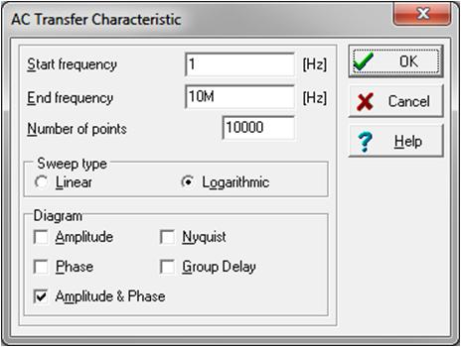
Spice Compared with Calculated Analysis
SPICE AC Analysis:
For best accuracy use highest resolution
i.e. maximum “Number of Points”
Note:
1) SPICE analysis accounts for loop gain effects and closed loop phase shifts
due to op amp Aol.
2) Calculated results do not account for loop gain effects and closed loop phase shifts
due to op amp Aol.
<number>

Slide 47
Closed Loop Gain: Magnitude and Phase
SPICE Ideal Op Amp & Poles: Equivalent Circuit
Note:
1) SPICE - Ideal Circuit analysis matches Calculated results.
2) No loop gain effect or closed loop phase shifts due to op amp Aol.
<number>

Slide 48
Closed Loop Gain: Magnitude and Phase
SPICE Ideal Op Amp & Poles: Equivalent Circuit
<number>

Slide 49
3) Dual Feedback Paths and 1/β
<number>

Slide 50
Dual Feedback and 1/β Concept
Analogy: Two people are talking in your ear. Which one do you hear? The one talking the loudest!
Dual Feedback: Op amp has two feedback paths talking to it. It listens to the one that feeds back the largest voltage (β = V_{FB} / V_{OUT}). This implies the smallest 1/β!
Dual Feedback Networks:
Analyze & Plot each FB#? 1/β
Smallest FB#? dominates 1/β
1/β = 1 / (β1 + β2)
1/β relative to V_{O}
Note: V_{O} = Op Amp Aol Output before
Ro for this Dual Feedback Example
<number>
Notes:
<number>
In this slide we see an op amp circuit which uses two feedback paths. The first feedback path, FB#1, is out of the op amp, through Riso and CL back through RF and RI to the –input of the op amp. The second feedback, FB#2, is out of the op amp, through CF and back to the –input of the op amp. The equivalent 1/β plots for each of these feedbacks are plotted separately. When more than one feedback path is used around an op amp the feedback path which feeds back the largest voltage to the op amp’s input will become the dominant feedback path. This implies that if 1/β is plotted for each feedback that the feedback with the lowest 1/β at a given frequency will dominate at that point. Remember that the smallest 1/β implies the largest β and since β = V_{FB}/V_{OUT}, the largest β implies the most voltage fed back to the input of the op amp. An easy analogy to remember is that if two people are talking to you in one ear which person do you hear the easiest – the one talking the loudest! So the op amp will “listen” to the feedback path with the largest β or smallest 1/β. The net 1/β plot the op amp sees is the lower one at any frequency of FB#1 or FB#2.

Slide 51
Dual Feedback and 1/β
How will the two feedbacks combine?
Answer:
The Largest β (Smallest 1/β) will dominate!
Small 1/β
Large 1/β
<number>
Notes:
<number>
When using dual feedback paths around op amp circuits the largest β path will dominate. An easy analogy to remember is that if two people are talking to you in one ear which person do you hear the easiest – the one talking the loudest! So the op amp will “listen” to the feedback path with the largest β or smallest 1/β. The net 1/β plot the op amp sees is the lower one at any frequency of FB#1 or FB#2.

Slide 52
Dual Feedback and the BIG NOT
WARNING: This can be hazardous to your circuit!
Dual Feedback and the BIG NOT:
1/β Slope changes from +20db/decade to -20dB/decade
Implies a “complex conjugate pole ” in the 1/β Plot with small damping ratio, ζ.
Implies a “complex conjugate zero” in the Aolβ (Loop Gain Plot) with small damping ratio, ζ.
+/-90° phase shift at frequency of complex zero/complex pole.
Phase slope from +/-90°/decade slope to +/-180° in narrow band near frequency
of complex zero/complex pole depending upon damping ratio, ζ.
Complex zero/complex pole can cause severe gain peaking in closed loop response.
<number>
Notes:
<number>
When using dual feedback paths around an op amp there is one extremely important case to avoid – the “BIG NOT”. As demonstrated in this slide there op amp circuits which can result in feedback paths that create the BIG NOT, which is seen in the net 1/β plot that contains a net 1/β slope which changes from +20db/decade to -20dB/decade abruptly. This rapid change implies a complex conjugate pole in the 1/β plot with a small damping ratio, ζ , which is therefore a complex conjugate zero in the Loop Gain plot. Complex zeros and poles create a +/-90 degree phase shift at the frequency of the complex zero/complex pole. In addition the phase slope around a complex zero/complex pole can range from +/-90 degrees to +/-180 degrees in a narrow frequency band around the frequency location of the occurrence. Complex zero/complex pole occurrences can cause severe gain peaking in the closed loop op amp response. This can be very undesirable especially in power op amp circuits.

Slide 53
Complex Conjugate Pole Phase Example
From: Dorf, Richard C. Modern Control Systems. Addison-Wesley Publishing Company. Reading, Massachusetts.
Third Edition, 1981.
<number>
Notes:
<number>
The phase plot for a complex conjugate pole is shown in this slide. It is clear that, depending upon the damping factor, the phase shift can be dramatically different than one for a simple double pole which we would expect to be -90 degree shift at the frequency and a -90 degree/decade slope (damping factor=1).

Slide 54
Dual Feedback and 1/β Example
Dual Feedback:
FB#1 through RF forces accurate Vout across CL
FB#2 through CF dominates at high frequency for stability
Riso provides isolation between FB#1 and FB#2
<number>
Notes:
<number>
This Dual Feedback and 1/β example demonstrates the Riso w/Dual Feedback circuit. FB#1, through RF, provides direct feedback across the load, CL, and thereby forces Vout to equal VREF. FB#2, through CF, provides a second feedback path, which dominates at high frequency, to guarantee stable operation. Riso creates the isolation between FB#1 and FB#2.

Slide 55
Zo External Model for Dual Feedback Analysis
Zo External Model:
VCV1 ideally isolates U1 so U1 only provides data sheet Aol
Set Ro to match measured Ro
Analyze with unloaded Ro (largest Ro) which creates worst instability
Use 1/β on Aol stability analysis
1/β, taken from VOA will include the effects of Zo, Riso and CL
<number>
Notes:
<number>
The Zo External Model shown above allows for us to measure the effects of Zo interacting with Riso, CL, RF, and CF on 1/Beta. In our Zo External Model set Ro = Ro for OPA177, measured to be 60 ohms. The voltage-controlled–voltage-source, VCV1 isolated our op amp macromodel, U1, from Ro, Riso, CL, CF, and RF. VCV1 is set to x1 to keep the data sheet Aol gain the same. Remove any large DC load since we want to analyze this circuit under worst case stability conditions which will be with CL only and our calculated unloaded Zo (Ro=60 ohms for this case). VOA is an internal node to the op amp which in the real world cannot be measured. It is also not easy to access this internal node on many SPICE macromodels. 1/Beta is analyzed relative to VOA to include the effects of Ro, Riso, CL, CF, and RF. Final stability simulation in SPICE, without using the Zo External Model cannot plot 1/Beta but can plot Loop Gain to confirm our analysis using the ZO External Model.

Slide 56
Dual Feedback, FB#1 And FB#2
FB#1
FB#2
FB#1 and FB#2 1/ β Analysis:
There is only one net voltage fed back as β to the -input of the op amp
β_net = β_FB#1 + β_FB#2
This implies that the largest β will dominate → smallest 1/ β will dominate
Analyze FB#1 with CF = open since it will only dominate at high frequencies
Analyze FB#2 with CL = short since it is at least 10x CF
<number>
Notes:
<number>
For this Riso with Dual Feedback topology can analyze each feedback path, FB#1 and FB#2 independently and plot their resulting 1/β plots on the Aol curve of the op amp. The net 1/β the op amp will respond to will be the lowest 1/β of either FB#1 or FB#2 at any point in frequency.

Slide 57
Dual Feedback and 1/β Example
<number>
Notes:
<number>
For our Dual Feedback example we see the 1/β plotted for each feedback path, FB#1 and FB#2, independently with the net 1/β being the lower of the two that any point in frequency.

Slide 58
Dual Feedback and 1/β – Create the BIG NOT
<number>
Notes:
<number>
We will use the circuit above to purposely create the BIG NOT.

Slide 59
Dual Feedback and 1/β – Create the BIG NOT
<number>
Notes:
<number>
By adjusting FB#2 improperly we are able to create the BIG NOT in the net 1/β plot.

Slide 60
Dual Feedback and 1/β – Create the BIG NOT
BIG NOT
BIG NOT 1/β: At fcl rate-of-closure rule-of-thumb says circuit is stable but is it?
<number>
Notes:
<number>
SPICE analysis of our BIG NOT circuit confirms we have created the BIG NOT in the 1/β plot.

Slide 61
Dual Feedback and 1/β – Create the BIG NOT
BIG NOT Loop Gain:
Loop Gain phase shift >135 degrees (<45 degrees from 180 degree phase shift) for frequencies <fcl which violates the loop gain phase buffer rule-of-thumb. But is it stable?
<number>
Notes:
<number>
Loop gain confirms that our BIG NOT circuit has a very abrupt phase shift around 2kHz.

Slide 62
Dual Feedback and 1/β – Create the BIG NOT
<number>
Notes:
<number>
We will use this circuit to run a transient closed loop analysis to see how our BIG NOT circuit would perform in the real world.

Slide 63
Dual Feedback and 1/β – Create the BIG NOT
BIG NOT Transient Stability Test:
Excessive ringing and marginal stability are apparent. Real world implementation and use may cause even more severe oscillations. We do not want this in production!
<number>
Notes:
<number>
A closed loop transient test of our BIG NOT circuit shows we do not end up with desirable results for a disturbance in the op amp circuit.

